Slide 1
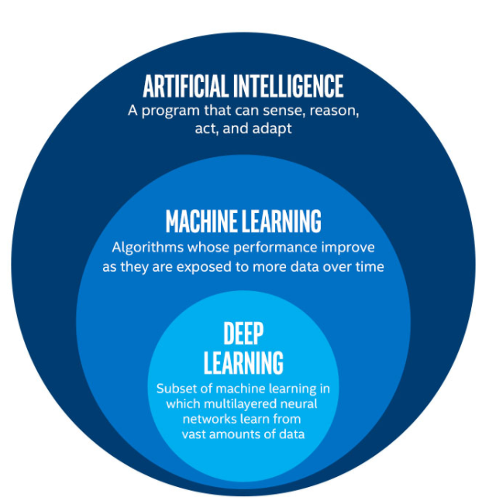
“AI is akin to building a rocket ship. You need a huge engine and a lot of fuel. If you have a large engine and a tiny amount of fuel, you won’t make it to orbit. If you have a tiny engine and a ton of fuel, you can’t even lift off. To build a rocket you need a huge engine and a lot of fuel. The rocket engine is the learning algorithms, but the fuel is the huge amounts of data we can feed to these algorithms”

Slide 2

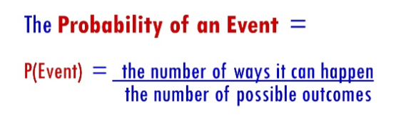
Probability
Probability is the branch of mathematics concerning numerical descriptions of how likely an event is to occur, or how likely it is that a proposition is True.
The principles of Machine Learning are largely dependent on effectively handling the uncertainty in data and predicting the outcome based on data in hand.

Slide 3

Conditional Probability
Conditional probability is a measure of the probability of an event occurring, given that another event (by assumption, presumption, assertion or evidence) has already occurred
If the event of interest is A and the event B is known or assumed to have occurred, "the conditional probability of A given B", or "the probability of A under the condition B", is usually written as P(A|B).
P(A n B) is the probability that both events A and B occur.

Slide 4
Example
If you pick a card from the deck of cards, can you guess the probability of getting a queen from the deck of cards?
Well, we have already set a condition that the card is a club. So, the denominator (eligible population) is 13 and not 52. And since there are only four queens in deck of cards, the probability it is a queen is 1/13 = 0.077

Slide 5
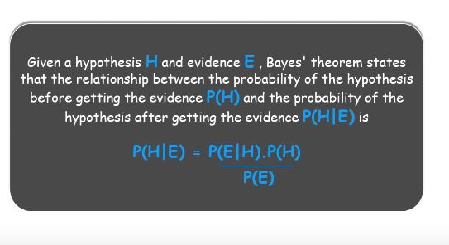
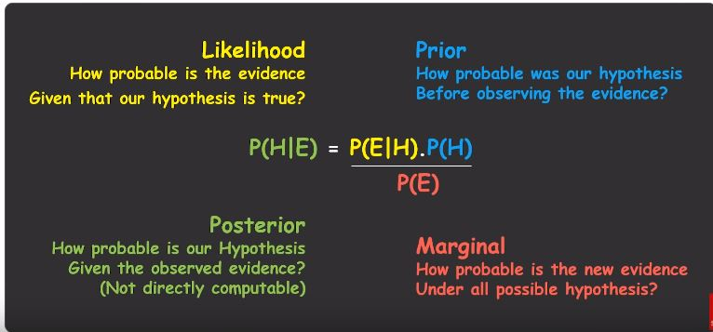
Bayes Theorem
Bayes Theorem is a way to figure out Conditional Probability where Conditional Probability is Probability of an event happening given that it has some relationship to one or more other events.

Slide 6
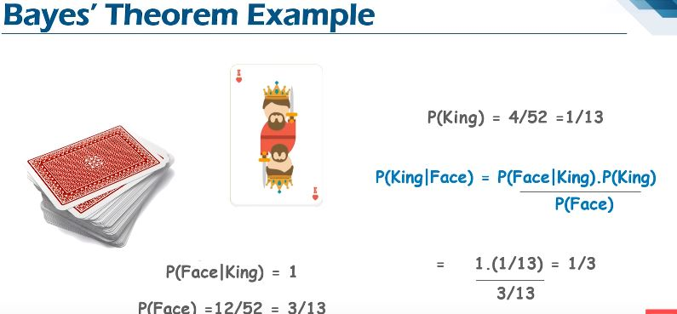

Slide 7
What is Naïve Bayes?
It comprises of two parts which is Naive (showing a lack of experience, as it assumes that one feature in a model is independent of existence of another feature).
Bayes, in simple terms Naive Bayes Classifier assumes that the presence of a particular feature in a class is unrelated to the presence of any other feature, even if this features depend on each other or upon the existence of the other features all of these properties independently contribute to the Probability

Slide 8
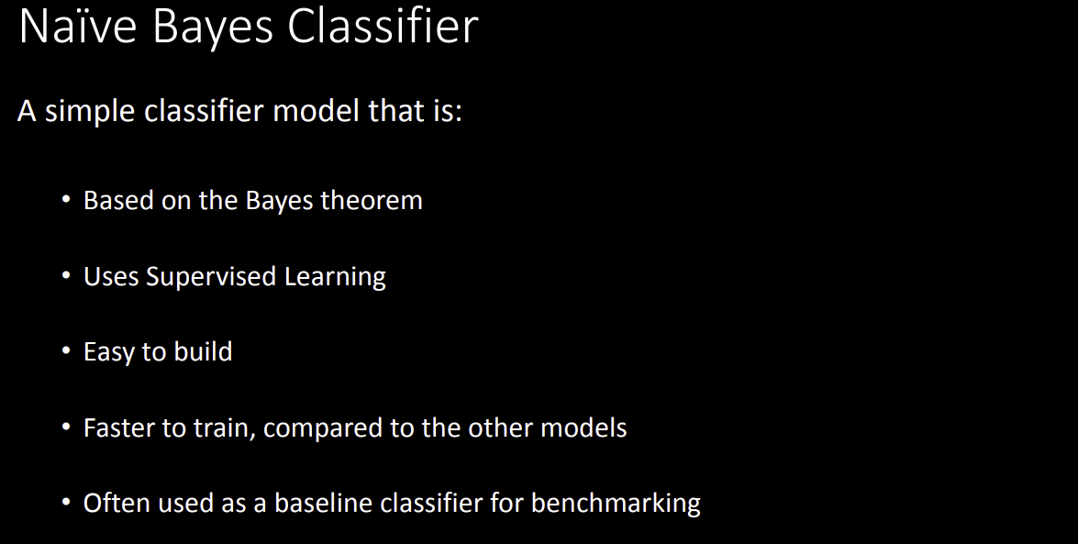

Slide 9
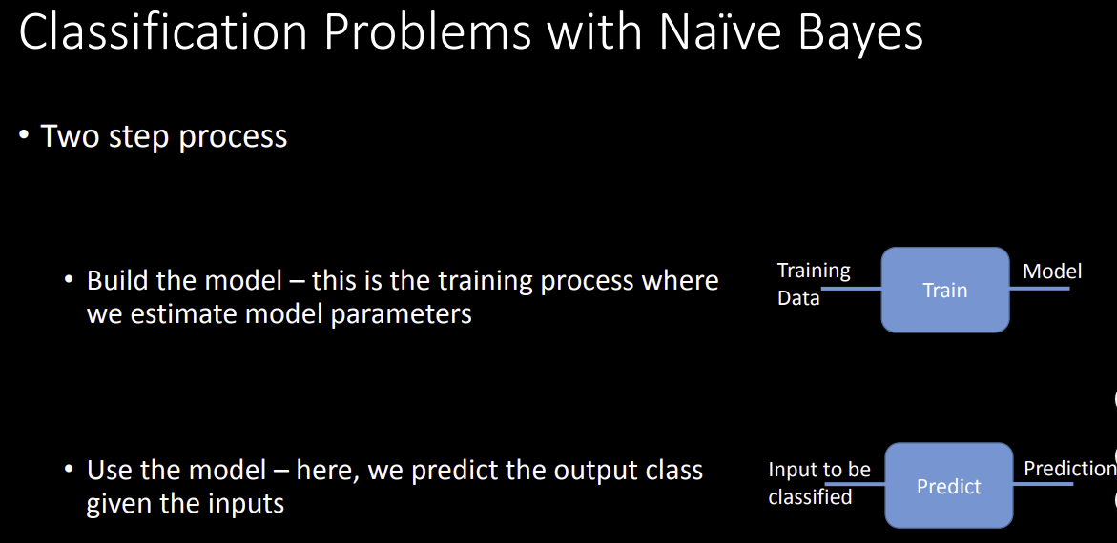

Slide 10

Types of Naïve Bayes
Gaussian Naïve Bayes : It is used in Classification and it assumes that the feature follow our Normal Distribution. A Gaussian distribution is also called Normal distribution. When plotted, it gives a bell shaped curve which is symmetric about the mean of the feature values.
Multinomial : It is used for Discrete Counts for eg: We have a Text Classification Problem where we consider trials and checking the word occurring in the document we have count how often the word occurs in the document.

Slide 11


